Slide 1
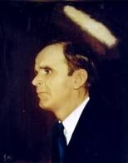

THERE IS NO MOUNTAIN
I’ve been on the mountain and in the valley so low,
When it seemed like never I had a place to go
Then I found Jesus, now He is mine
And there is no mountain that I can’t climb.

Slide 2
CHORUS
There is no mountain that WE can’t climb,
When I say WE, I mean Jesus and ME
If you’ve got Jesus and He is thine,
There is no mountain that you can’t climb.

Slide 3
I was in despair and trouble beset me
Tears filled my eyes and I could not see
Then I trusted Jesus, and His love divine
Now there is no mountain that I can’t climb.

